Slide 1

Thank you for Your Interest in Serving as Site Preceptor for the Mel and Enid Zuckerman College of Public Health

Slide 2
Public Health Undergraduate Intern Experience
Presentation developed by Amarachi Obi,
Intern with the MEZCOPH Academic Health Department

Slide 3
Course Requirements Prior to
Internship Enrollment
EPID 309: Introduction to Epidemiology
PHPM 310: Health Care in the U.S.
EHS 375: Introduction to Environmental and Occupational Health
BIOS 376: Introduction to Biostatistics
HPS 350: Principles of Health Education and Health Promotion
HPS 200: Introduction to Public Health
HPS 178: Personal Health and Wellness

Slide 4
Undergraduate Internship Overview
First professional experience for many undergraduate students
Undergraduate interns are encouraged to start their internship by observing their preceptor
Interns are expected to work alongside their supervisor or preceptor to apply skills learned in the classroom (examples: public speaking skills or organizational skills)
Preceptor and intern will work together to develop an internship work plan
Work plan will include
  Internship purpose statement
  3-5 learning objectives
  Activities for each learning objectives

Slide 5
To enroll in the major, students must choose one of the following concentrations:
Environmental and Occupational Health
Global Health
Health Promotion
Health Systems Theory and Practice
Quantitative Methods in Public Health
B.S.
Concentrations

Slide 6
Required Courses Within Specific Concentratons
Environmental and Occupational Health
EHS 422: Safety Fundamentals
EHS 439A: Outbreaks and Environmental Biology: Then to Now
Global Health
HPS 409: Global Water, Sanitation and Hygiene (WaSH)
EPID 479: Infections and Epidemics
HPS 404: Fundamentals of Evaluation
Health Promotion
HPS 400: Contemporary Community Health Problems
HPS 481: Health Education Intervention Models
Health Systems Theory and Practice
HPS 402: Corporate Wellness
PHPM 415: Strategic Planning
Quantitative Methods in Public Health
EPID/BIOS 453: Health Data Science Practice

Slide 7
Most students complete their internship during their Spring semester Junior or Over the course of senior year

Slide 8
Internship Structure
All undergradute students will complete a total of 6 units of internship to fulfill their degree requirement
  Students may take all 6 units at once in a semester or divide their internship between two semesters at 3 units each
  Contact hours include any internship-related activities. Examples include orientations, meetings, events, assigned work, sending emails, etc.
    A total of 250 contact hours are required for a 6-unit internship
    A total of 125 contact hours are required for a 3-unit internship
A work plan is established between the student and preceptor (site supervisor) ahead of the internship start date
  The work plan acts as a mutually-agreeable internship purpose statement, with 3-5 learning objectives, and a list of activities that will meet the objectives
The MEZCOPH Preceptor Agreement is completed by preceptor and approved by the Internship Instructor

Slide 9
Internship Structure
In addition, student will complete 20 hours of class work outside of internship duties, including tracking hours on an activity log, writing about their experience, and developing a professional online presence
  The site preceptor will participate by signing off on hours and evaluating the intern both at the midterm and end of the internship semester

Slide 10
Relationship Between Undergraduate Intern, Preceptor, and Internship Instructor
Contact between the student intern, preceptor and internship director is frequent over the course of the semester.
The site preceptor serves as a role model to the student and aids the student in the development/revision of the internship work plan.
The student is expected to maintain good communication with both their site preceptor and internship instructor, as well complete the duties assigned to them by their agency.

Slide 11
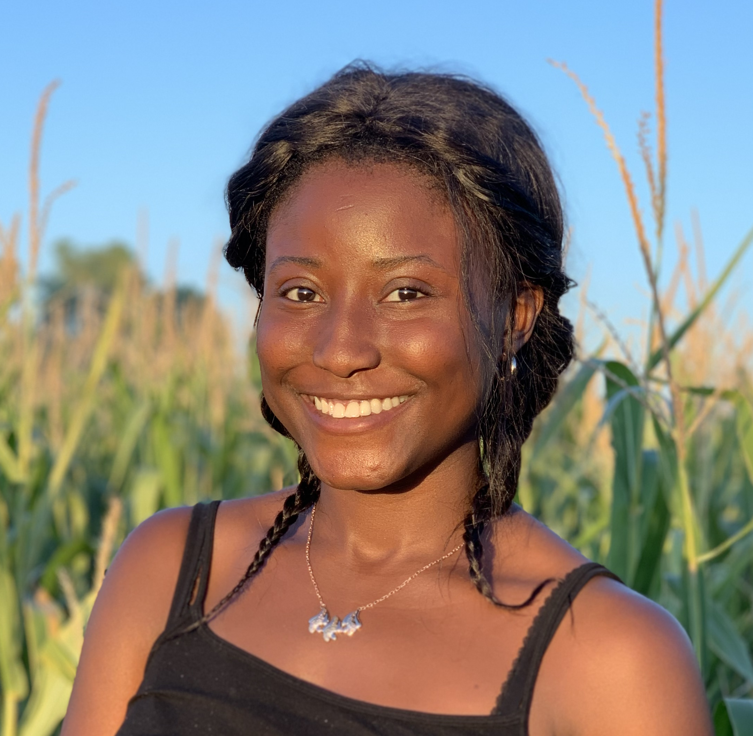
Introducing Amara Obi, Undergraduate Public Health Intern
As an intern, I assist my supervisor with coordinating activities for the Academic Health Department with Pima County Health Department.
Some of these duties include coordinating tours of the college, organizing networking events, and working on an internship training video for potential, future site preceptors.

Slide 12
Where do I intern?
I work under the Community Outreach and Engagement Coordinator (my preceptor) at the Mel and Enid Zuckerman College of Public Health (MEZCOPH) in Tucson, Arizona
My role has taken me around the Tucson community to Pima County Health Department (PCHD) satellite locations to find ways to engage with public health practitioners

Slide 13
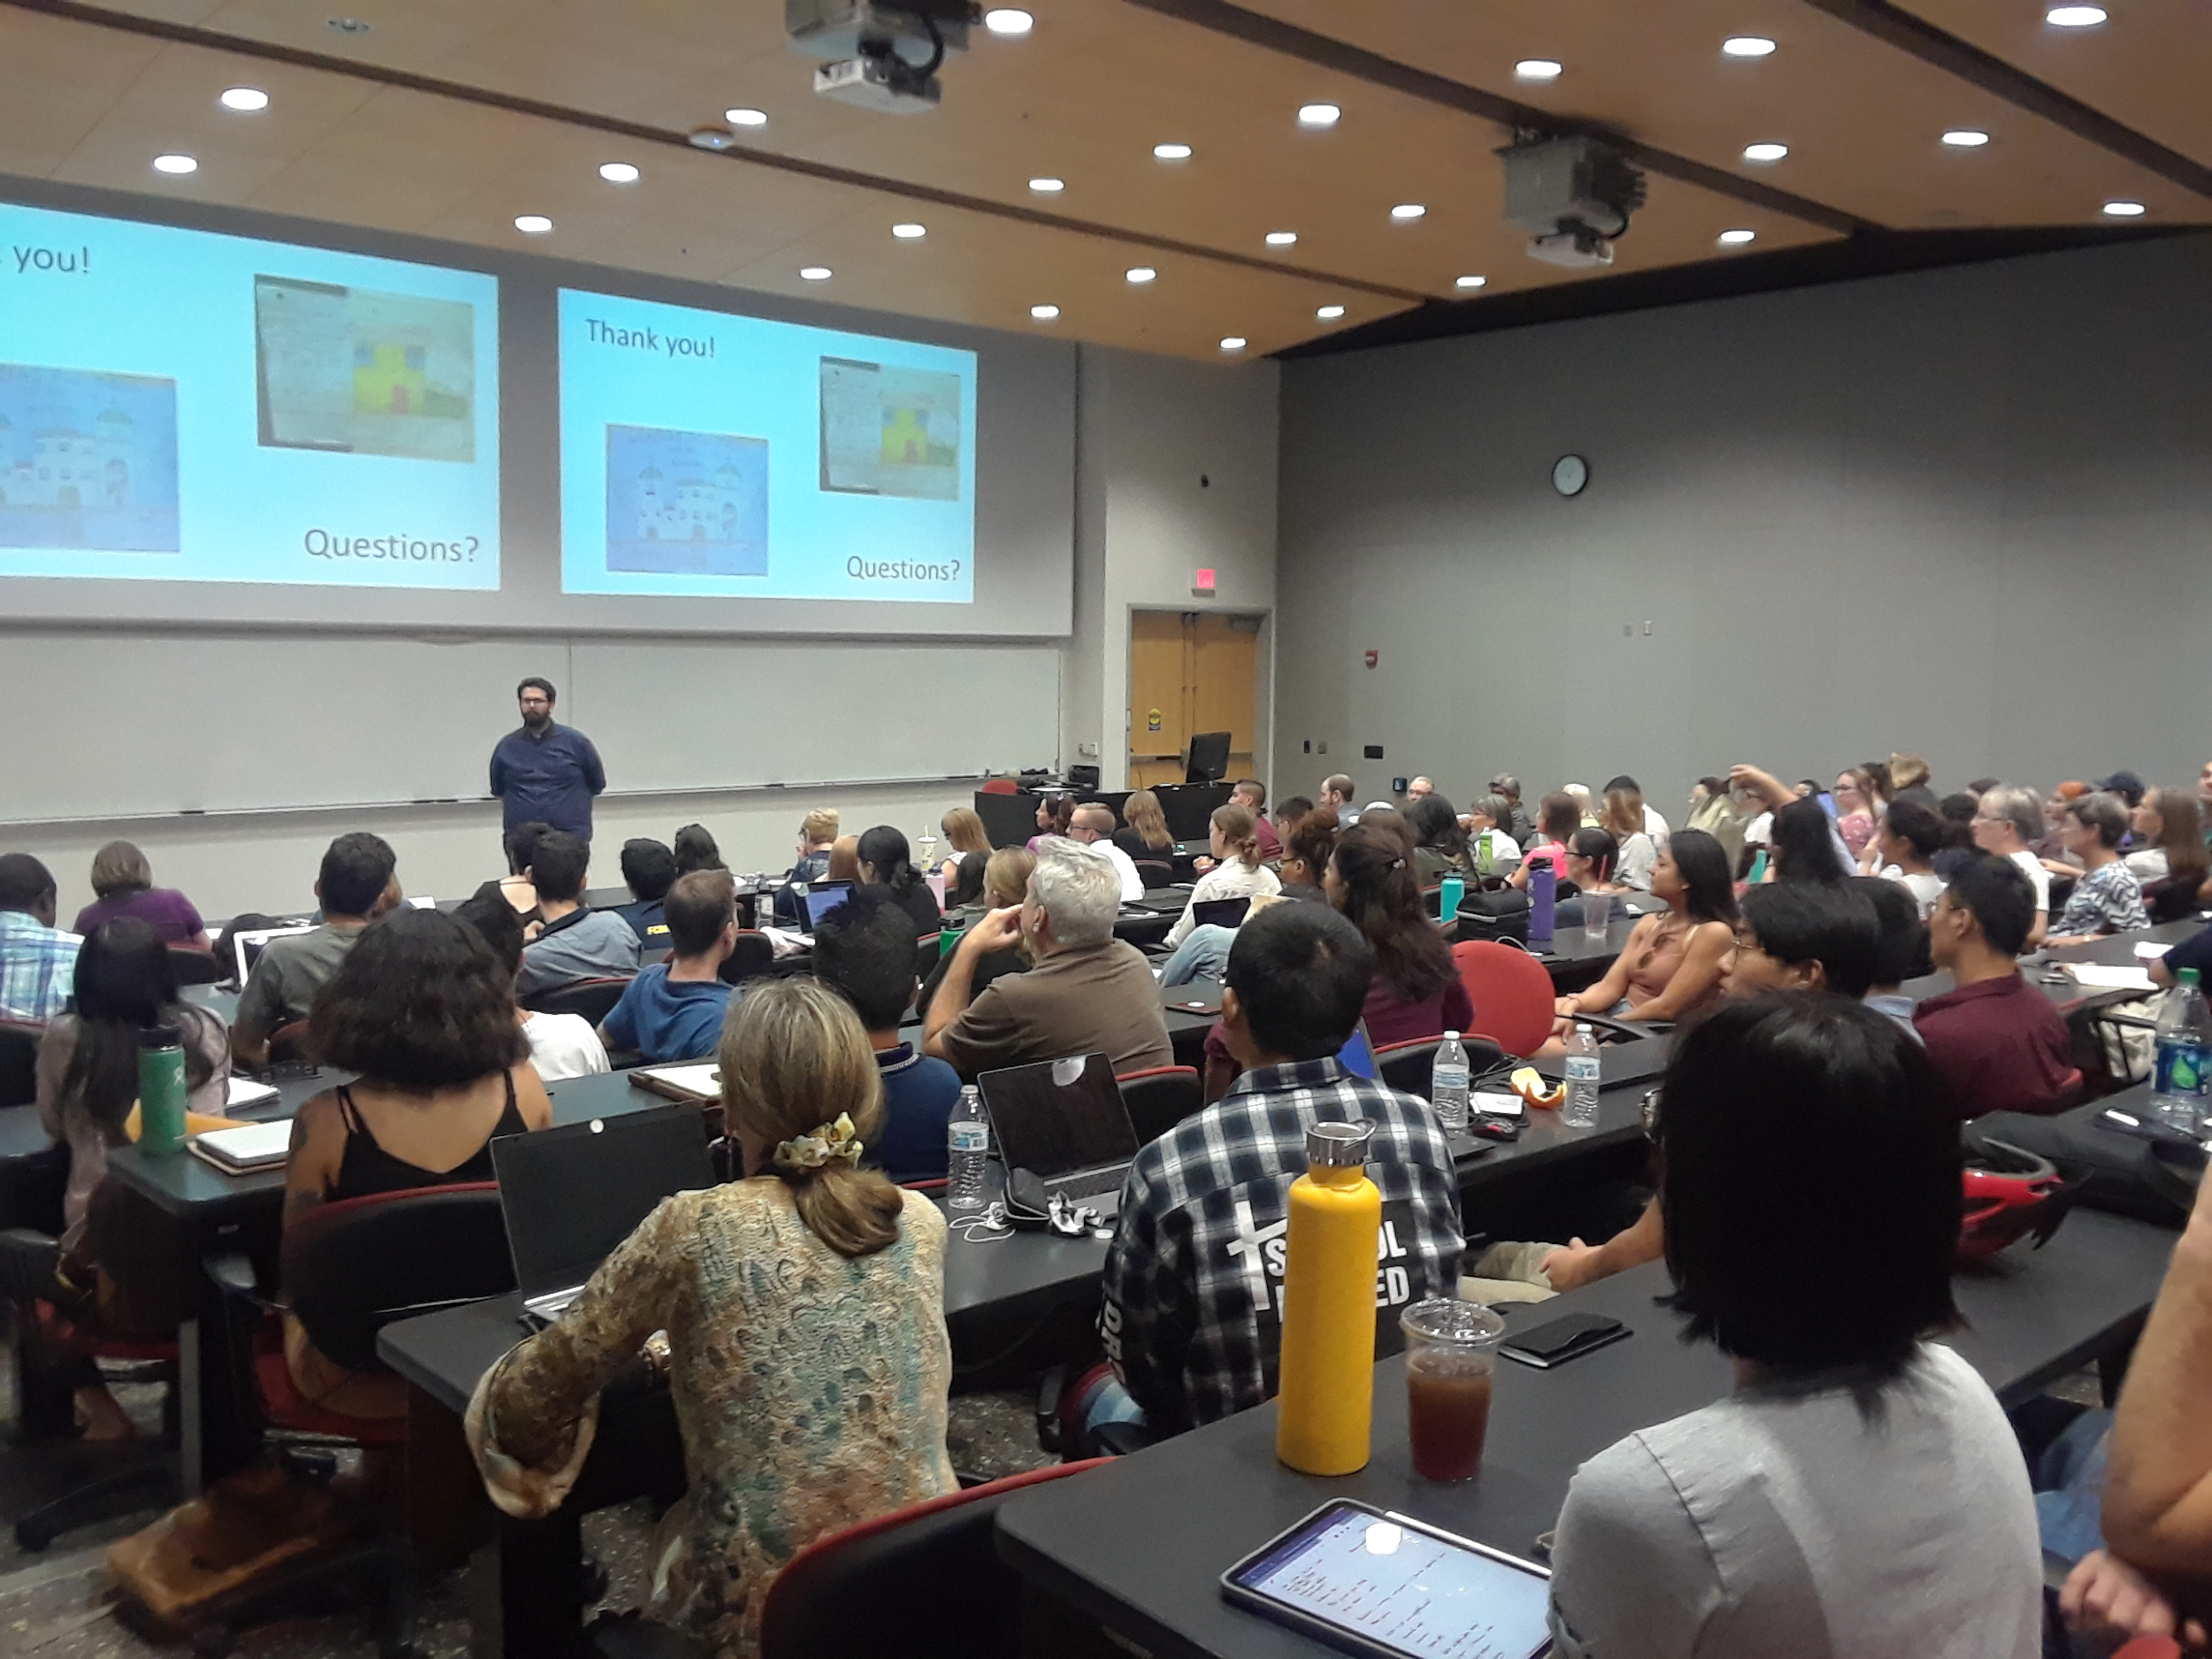
AMara’sInternship Activities!
One of my main roles this semester has included supporting the coordination of the monthly College-Wide Seminars hosted by MEZCOPH. In particular, I organize events with Pima County Health Department staff who visit MEZCOPH during the event.
I had the privilege of leading tours of MEZCOPH for PCHD staff and organizing networking events, with my internship preceptor, for PCHD staff and MEZCOPH faculty members following these College-Wide Seminars. Before the tours, I recruit 6-7 faculty members who provide infrormation on their programs and research during these tours.
Photo I took at College-Wide Seminar on September 11th

Slide 14
Amara’s Internship Activities con’t.
As well as being heavily involved in the coordination of monthly College-Wide Seminars, I also developed this internship training video for potential internship site preceptors at various health departments in Arizona.
This role has been unique, because I am helping to develop media for future preceptors to learn more about the internship process and the types of relationships and activities they can develop and foster for student interns.

Slide 15
Public Health Graduate (MPH)
Intern Experience

Slide 16
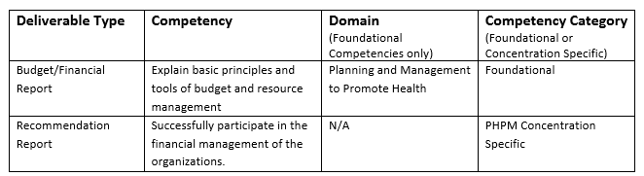
MPH Internship Overview
All MPH students are required to complete an internship with an agency/community partner. The internship requires the MPH student to synthesize, integrate, and apply knowledge acquired in coursework to a project in a professional applied practice setting.
Interns are expected to produce one or two deliverables (differs depending on the student) as a result of the internship. The deliverable(s) should benefit the agency.
The student will match the deliverable(s) to the appropriate public health competency, domain, and competency category.
Example Internship Deliverable Matching Table

Slide 17
Course Requirements Prior to Internship Enrollment
On Campus MPH: All students must complete 3 of the 5 core courses, plus any required concentration courses, before starting the internship.
Online MPH: Students must complete all core courses before starting the internship.
MPH Required Core Courses
EPID 573 A: Basic Principles of Epidemiology
PHPM 574: Public Health Policy and Management
EHS 575: Environmental and Occupational Health
BIO 576A: Biostatistics in Public Health
HPS 577: Sociocultural and Behavioral Aspects of Public Health
Internship Preparation Workshop (required; no credit)
* PHPM 569 Fundamentals of Health Budgeting and Financial Management
* Required core course the for Online MPH Program

Slide 18
MPH Concentration-Specific Requirements
Before Beginning an Internship
(on campus programs only)
Biostatistics
  BIOS 576 A- Biostatistics in Public Health (3 credits)
  BIOS 576 B – Biostatistics for Research (3 credits)
Environmental Health
  EHS 502- Environmental Monitoring and Analysis ( 3 credits)
  EHS 584 - Fundamental of Industrial and Environmental Health (3 credits)
Epidemiology
  EPID 573 B – Epidemiologic Methods (3 credits)
  BIOS 576 B – Biostatistics for Research
Family and Child Health- Maternal and Child Health Track
  HPS 586 Maternal and Child Health (3 Credits)
  One (1) planning and evaluation course

Slide 19
MPH Concentration-Specific Requirements
Before Beginning an Internship
(on campus programs only)
Family and Child Health- Global Health Track
  HPS 586 Maternal and Child Health (3 Credits)
  HPS 533 Global Health (3 credits)
  One (1) planning and evaluation course
Health Behavior Health Promotion
  HPS 532 A - Applied Aspects of Program Planning (3 credits)
Health Services Administration Track
  No Additional Prerequisites
One Health
  EPID 596 D- Public Health Experience - Student Epidemiology Response Team (SAFER)
Public Policy and Management
  No additional prerequisites

Slide 20
MPH Internship Credit Hour Requirements
Biostatistics- 5 credit hours
Epidemiology- 4 credit hours
Environmental Occupational Health- 6 credit hours
Family and Child Health (Global and Maternal and Child)- 4 credit hours
Health Behavior Health Promotion- 4 credit hours
Health Services Administration- 5 credit hours
One Health- 3 credit hours
Public Health Policy Management-
3 credit hours
* Each hour = 45 hours of internship work
* Internships may be split over semesters

Slide 21
Online MPH Program
Concentrations
  Applied Epidemiology
  Health Promotion
  Health Services Administration
5 credit internship spread out throughout 2nd year in the program (Fall, Spring, Summer)
  45 credit hours = 225 hours total

Slide 22
Requirements Before Beginning the MPH Internship
Students will complete the internship preparation workshop, obtain human subjects training certification, and complete UA IRB documents
Internship Plan
  Prepared by the student intern. Discussed and agreed to by the preceptor, intern faculty advisor, second committee member (not required), and student intern
  The Plan will include:
    Justification of Site
    Goals and Planned Outcomes
    Learning Objectives
    Internship Activities
    Proposed Timeline
    Deliverable(s) and Competencies
MEZCOPH Preceptor Agreement
  Completed by preceptor and approved by Internship Faculty Advisor

Slide 23
Responsibilities of the MPH Student Intern
Develop the internship project in consultation with the internship committee to reflect career goals, public health interests, and masters-level objectives
Submit completed Plan for Internship Form and other required documentation
Consult with the internship committee at critical points in development, during, and at the conclusion of the internship
Meet the hourly time commitment as established by concentration area for the internship project
Extend invitation to the Internship Preceptor to attend the Internship Conference at which you are presenting
Present at the Internship Conference

Slide 24
Responsibilities of MPH Internship Preceptor
Contact the Internship Committee Chair or MPH Coordinator to discuss any concerns prior to signing internship plan
When presented with the Plan for Internship Form and its attachments, review and discuss as necessary
Complete and sign the Preceptor Agreement and provide CV or resume for the student to submit with planning paperwork
Provide the student with an orientation to the internship site
Supervise student’s activities at the internship site
Contact the student’s Internship Committee Chair or MPH Program Coordinator if egregious behavior occurs and/or continues to occur
Upon completion of project, submit the Preceptor’s Evaluation of Student Performance via electronic survey

Slide 25
Responsibilities of MPH Internship Committee Chair
Oversee planning of internship activities prior to finalizing the Plan for Internship; meet with the student to discuss the proposed internship project and timeline
Review project with the student to determine the need for possible IRB approval
When presented with the Plan for Internship and other required planning paperwork, review with committee members and discuss as necessary; require modifications from student as necessary
Develop specific timeline with the student for meeting report submissions
Review drafts of abstract and report to provide feedback for revisions
Assign final grade in consultation with other committee members
Communicate with the student intern throughout the internship process
Attend the Internship Conference and student’s presentation
Complete evaluation of the student’s final report

Slide 26
MPH Internship Conference
Each fall and spring term, MEZCOPH hosts an Internship Conference during which students present their internship projects in a professional format.
Public Health professionals within the state, alumni, current students, faculty, and community advocates are invited to attend.
Approximately one month prior to the Internship Conference, presenting students will be required to submit an internship abstract.

Slide 27
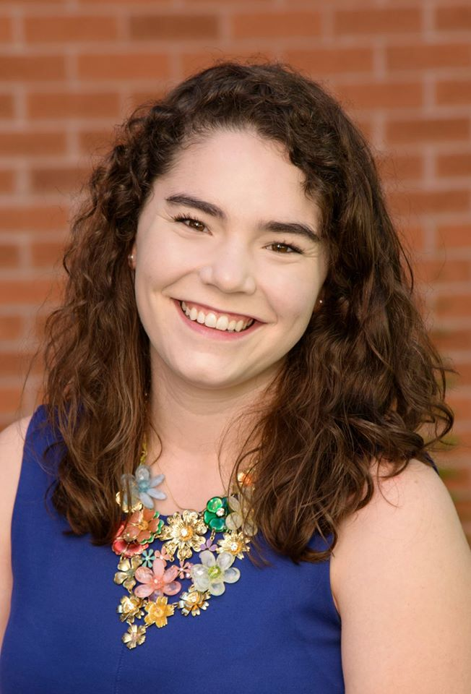
Introducing Laura Riley, Former MPH Public Health Intern
Laura Riley (MPH 2019), an Epidemiology MPH student, completed her internship with Pima County Health Department's Well Woman Health Check Program.
The Well Woman Health Check Program is a free breast and cervical cancer screening program for low-income, underinsured, and uninsured women.

Slide 28
Laura’s MPH Internship Activities
Conducted a literature review on best practices for developing a breast and cervical cancer screening program
Conducted interviews with Pima County clinic site managers and analyzed qualitative data to inform the creation of the patient stratification program evaluation
Utilized evidence-based practices and program theory to develop a patient satisfaction program evaluation questionnaire to improve patient access and care

Slide 29
Laura’s MPH Internship Deliverables
The literature review, key-informant interviews, and survey development resulted in two deliverables for Pima County Well Woman Program:
  Deliverable 1: Creation of a patient satisfaction program evaluation questionnaire
  Deliverable 2: An infographic displaying the results from the literature review

Slide 30
Keys to a Positive Experience with Your Undergraduate or Graduate Student Intern
Set Clear Deadlines
  Refer back to the Internship Plan frequently to help guide you
Communication
  Weekly Meetings
  Don’t hesitate to communicate with faculty member
  Great opportunity to network with faculty too!
If there is a problem, catch it early
  Provide your intern with weekly feedback
  Reach out to your intern

Slide 31
Common Questions
My intern has not been in contact with me, despite multiple attempts to reach them. What do I do?
  Contact the Undergraduate Internship Instructor (undergraduate students) or or Internship Chair (graduate students) to set up a meeting with the student. If your intern is a graduate student, and you don’t receive a response from the faculty member, reach out to the MPH Coordinator.
Do I need a dedicated working space for my intern?
  No. While you should have a time to meet with your intern weekly, some sites will require that the intern to work remotely. It is important the intern is interacting with you, participating in meetings, and is able to experience the culture of the organization.
I would like to host an intern, but I don’t know where to start. What do I do?
  Contact Emily Waldron, ewaldron@email.arizona.edu. Emily is more than happy to walk you through the process of developing an internship description and helping you to facilitate the internship description to students.

Slide 32
For questions contact:
Emily Waldron, MPH
Community Engagement and Outreach Coordinator
Mel and Enid Zuckerman College of Public Health
Email: ewaldron@email.arizona.edu
Phone: 520-626-9121

