Slide 1




Leaders across Borders: An evaluation for improvement
María Julia Mojardin López
Facultad de Medicina
Universidad Autonoma de Sinaloa
Dra. Cecilia Rosales
Mel & Enid Zuckerman College of Public Health;
Medical and Allied Health Sciences
August 07-2015

Slide 2

What is Leaders across Borders?
An advanced workforce development program aiming to develop leadership skills in public health professionals in the US-Mexico Border Region.
Funded in 2010 by the United States-Mexico Border Health Commission (USMBHC).
The curriculum was develop by the Mel and Enid Zuckerman COPH and the Mexican Section of the USMBHC.
https://www.emaze.com/@ALORCTWQ/HABILIDADES-DE-TRABAJO-EN-EQUIPO

Slide 3

The Main Aims of LaB
To develop collaborative leadership and health diplomacy skills in health-institution administrators.
To produce a collective impact on reducing pervasive health disparities on the U.S.-Mexico border
To improve quality life among US-MEX residents.
http://zonadeninos.com/analisis-mercado/

Slide 4
Learning objectives
Sensitize participants on the health needs of the border population to focus and prioritize actions in public health.
Develop participants’ leadership skills to improve the health situation along the US Mexico border communities.
Strengthen and emphasize the importance of diplomacy between the actors involved in binational health improvement.
Develop team based and collaborative projects to support and align with the BHC priorities.
Integrate collaborative networks among professionals to support binational leadership in public health.

Slide 5

LaB Through Four Generations
GENERATION | PARTICIPANTS
2010 | 18
2011 | 20
2013 | 17
2014 | 21
Phisicians
Nurses
Health Administrators
Health promoters
http://certification.acsm.org/blog/2013/may/interprofessional-competencies-in-healthcare-four-core-domains

Slide 6
LaB’s Follow Up:
What are we looking for?
General effects of the program
Specific benefits for participants
Significance of contents and dynamics of the program
Directions for improvement

Slide 7
How are we going to achieve that?
Population: 76 grads of the 4 LaB generations
Online Survey Administration (Qualtrics)
26 questions
Demographic information
General evaluation on contents, usefulness and professional/personal impact
Suggestions to improve program implementation
Notes:
Estudio cuantitativo a traves de una encuesta

Slide 8
How the survey will be administered?
Send an email
Send second email with the link of the survey
Collection of information
Data analysis and preparation of final report
http://creativemobilebusinessapps.com.au/mobile-forms-a-better-way-to-collect-information-businesses/
http://www.govdelivery.com/blog/email-communication/is-there-a-best-time-to-send-an-email/
http://www.tsncommunications.com/data-analysis-for-communications/
https://www.qualtrics.com/blog/
Notes:
1.- To confirm communication and disposition of the participant
2.-General recommendations to respond it.

Slide 9
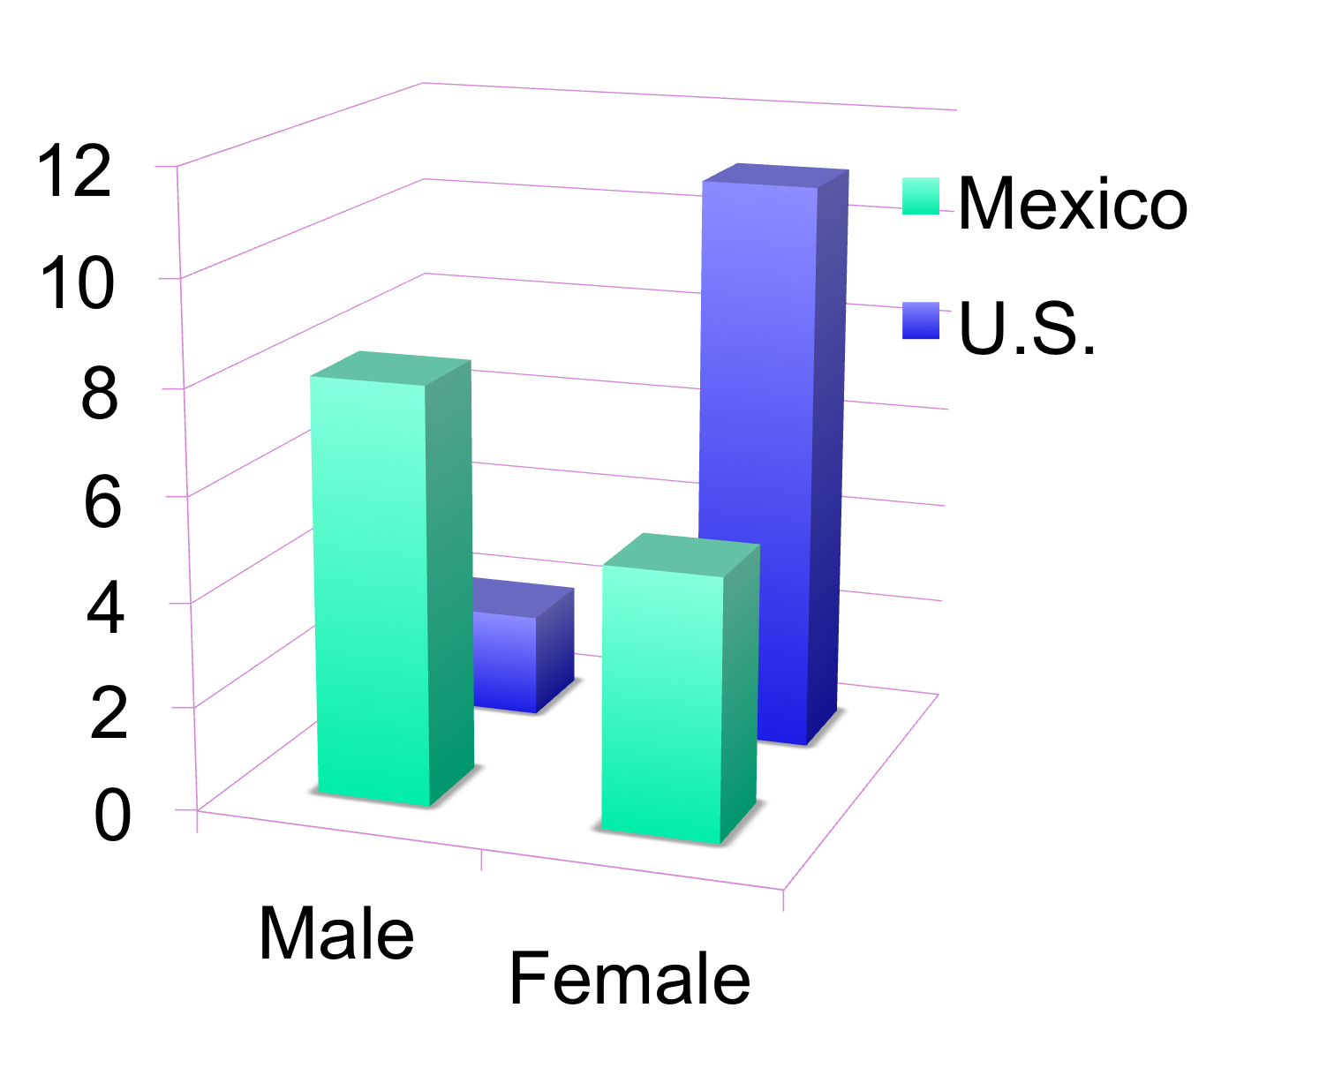
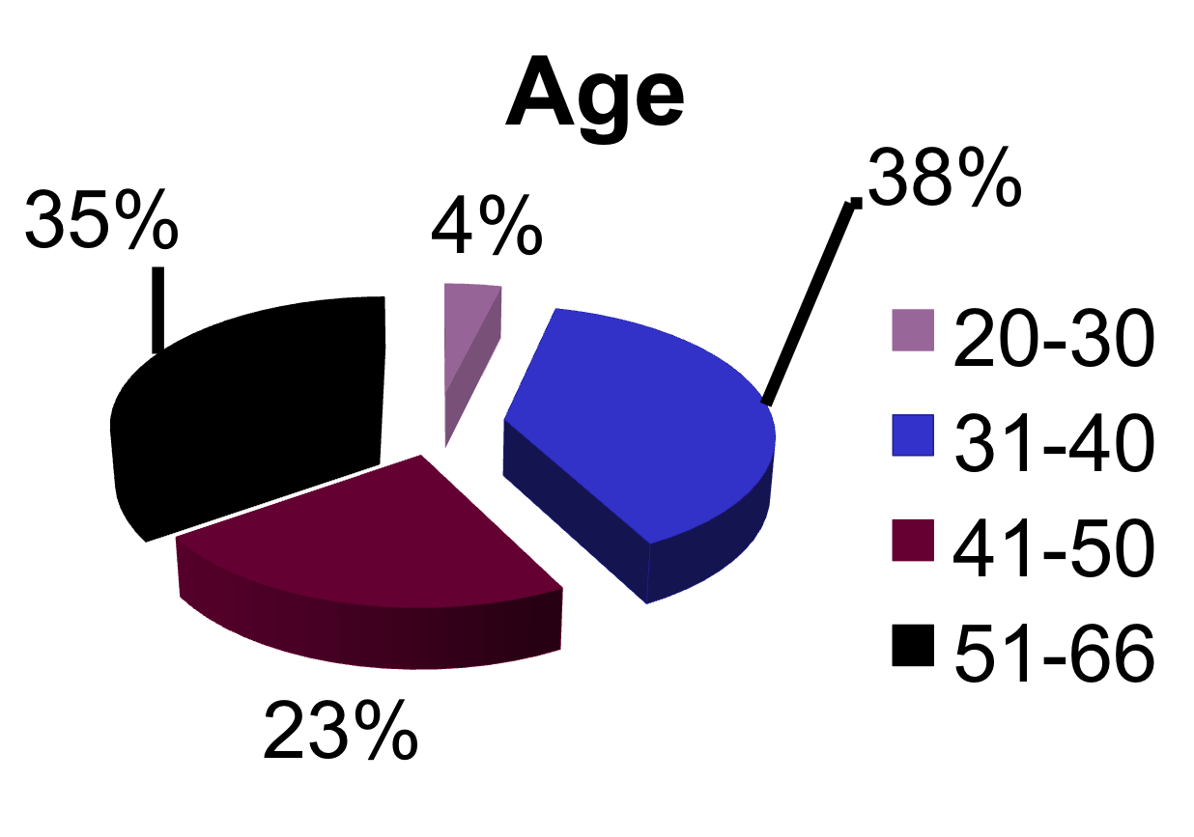
Results
Population: 26 participants
65% of the participants are part of binational projects.
70% of graduates are supervising from 3 to 6 workers.
46% have been promoted or taken new leadership positions since graduating LaB
100% rated the program materials as very useful to their work.
LaB help them be better prepared and have a broader view on public and border health issues.
Binational collaboration was enhanced.

Slide 10
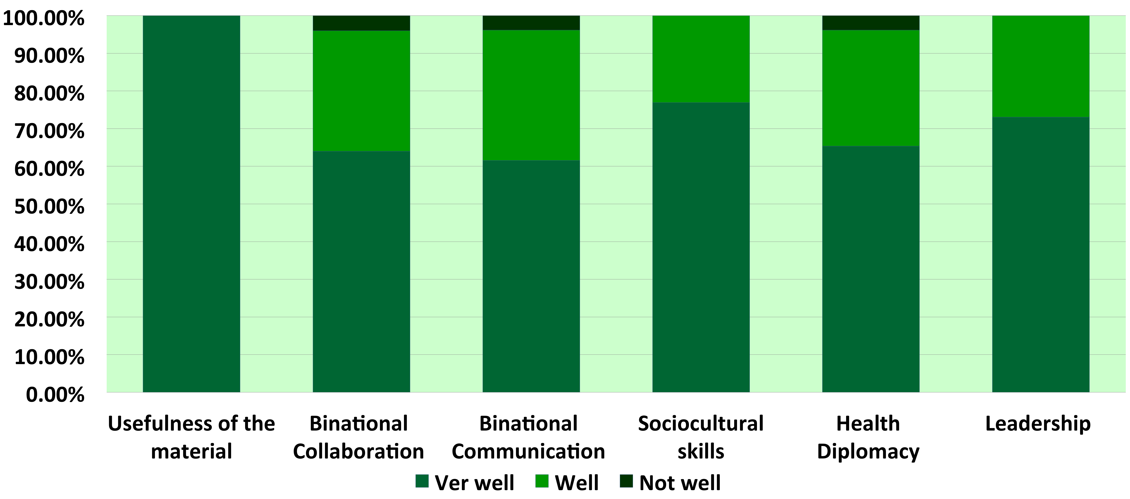
92% mentioned that they acquired these skills form LaB and they will be useful in future endeavors

Slide 11
Suggestions to improving
Emotional intelligence
Use of technology
Learn more about health system as well as social support
How to develop public polices about binational health needs
Decision making
Epidemiology problems on the border
How to prepare projects to attack different health needs in the region.

Slide 12
Conclusions
Leaders Across Borders had success in many areas:
LaB helped develop professional and personal skills,
Increased awareness and understanding of health needs in the geographic area,
Promoted intervention and policy alternatives across the Border,
Facilitated communication and joint efforts on common health and policy challenges.
Notes:
LaB helped participants increase binational relations and joint efforts.
LaB increased the participants’ interest in public health on the Border.
LaB increased participants’ personal skills for team working, customer service, and professional self confidence.
LaB content was professionally excellent, but inapplicable to their job.

Slide 13
Aknowledgments
This research was made thanks to the support of:
College of Public Health
United States-Mexico Border Health Commission
INAPI-Sinaloa
Facultad de Medicina, UAS, México.
Dr. Rogelio Zapata, Border Health Commission and Dr. Eduardo González, COLEF
Family

Slide 14
References
Leaders Program Summary and Evaluation
Wright, K. (2000). Competency Development in Public Health Leadership. American Journal of Public Health , 9 (8), 6.

