Slide 1

Organizational Health Equity Capacity Assessment for SVPEP Agencies in Arizona
Sexual Violence Prevention and Education Programs Summit
October 16, 2023

Slide 2
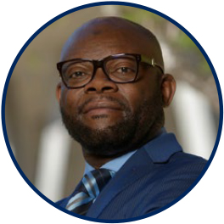

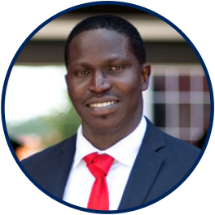
Our Team
John Ehiri, Ph.D.
Abidemi Okechukwu, MD, DrPH
Yemisi Ayoade, MD

Slide 3
Executive Summary
Background & Objectives
Approach & Methodology
Findings
Acknowledgment
Plenary: Recommendations
Presentation Outline

Slide 4
Executive Summary

Slide 5
Executive Summary
V
This summary provides feedback on organizational capacity and practice integrating health equity into SVPEP programs.
Method: Conducted qualitative interviews with 15 people from 6 organizations to assess staff knowledge, organizational policies and leadership actions, work plan activities, data collection, use and needs, training and TA, state of partnerships, and focus within the SEM model for health equity within their SVPEP work.
Findings: Knowledge is high, and practice is average, but strategic alignment with health equity is minimal.
Staff and organizations know health equity within their SVPEP programs and agencies. The staff mentioned various ways organizations implement health equity strategies within activities. However, most focused on the individual and group level and did not extend socio-economic or political determinants.
Interviews demonstrate minimal strategic alignments between health equity and SVPEP within budgets, work plans, data collection and use, and partnerships with other organizations.
However, interventions were limited to individual and group levels. Participants reported that limited funding and oversight prevented innovations that could allow for activities in the outer layers of the socioecological model.

Slide 6

Sexual Violence:
A Public Health Issue
Background

Slide 7
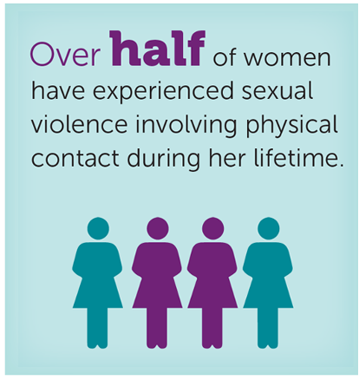
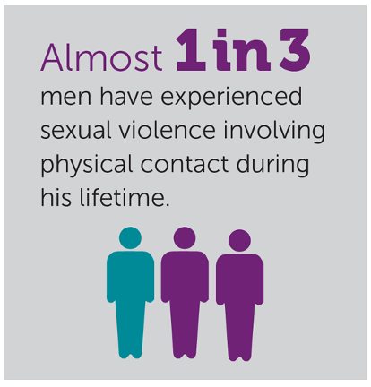
Sexual Violence
V
PRESENTATION TITLE | THE UNIVERSITY OF ARIZONA

Slide 8
Sexual Violence
V
Common phenomenon that occurs early in the lifespan.
Disproportionately affects some groups of people and perpetuates inequities.
Substantial health and economic costs on victims and systems of care.

Slide 9
CDC STOP SV Framework
 | Strategy | Approach
S | Promote SOCIAL NORMS that Protect Against Violence | Bystander approaches Mobilizing men and boys as allies
T | TEACH Skills to Prevent Social Violence | Social-emotional learning Teaching healthy, safe dating and intimate relationship skills to adolescents Promoting healthy sexuality Empowerment-based training
O | Provide OPPORTUNITIES to Empower and Support Girls and Women | Strengthening economic supports for women and families Strengthening leadership and opportunities for girls
P | Create PROTECTIVE Environments | Improving safety and monitoring in schools Establishing and consistently applying workplace policies Addressing community-level risks through environmental approaches
SV | SUPPORT VICTIMS/Survivors to Lessen Harms | Victim-centered services Treatment for victims of SV Treatment for at-risk children and families to prevent problem behavior including sec offending
Content from cdc.gov/violenceprevention/sexualviolence/fastfact.html
Notes:
A comprehensive approach
Represent multiple levels that impact relationships: Families, schools, communities, and social structures.
Utilizes the STOP SV framework

Slide 10
Objectives
V
Health inequities increase vulnerabilities to sexual violence. Prevention strategies require integrating social-level preventive strategies that address health inequities.
Evaluate the current practice of SVPEP in Arizona.
Assess grantee organizations' capacities and limitations to integrate health equity into practice.
Collate recommendations for integrating health equity into strategic and implementation SVPEP plans.

Slide 11
Approach & Methods

Slide 12





Approach: Equity Capacity Evaluation Framework
Capacity
Training & TA
Data Use & Needs
Partnership
Activities’ Focus
Staff knowledge and skills
Organizational policies
Leadership and support
Cultural competency
Community capacity building
Needed resources & training
Availability
Use
Needs
Types of partnerships
Alignment with other organizations
Engagement strategies
Relationship
Community
Societal
Environmental
Policies

Slide 13
Methodology
V
Developed and tested an interview guide using the equity capacity framework.
Purposive selection of grantee organizations provided by ADHS
Demographic information was collected through a pre-interview survey.
Qualitative interviews were conducted for 2-3 staff per organization. Interviews were recorded and transcribed.
Conducted thematic and framework analyses of interview transcripts.

Slide 14
Findings

Slide 15
Demography
V
Parameter
Participants | 15 participants with Target populations: school-aged children, college students, community members.
Organizations | Six 1 Higher Institution 1 County Office 1 Coalition organization 3 NGOs
Range of Staff Size | 2- 27 per organization
Types of Organizations | University centers, Non-profit Organizations, Coalitions and Foundations Arizona State University, Yavapai County Community Health Services, ACESDV, Peer Solutions, Northland Family Help Center, Southern Arizona AIDS Foundation.
Focus Population | Middle, high school, and college students Native Americans in Northern Arizona LGBTQIS+ students for college-based programs Racial minorities (Latinx, African-American) for organizations that work in urban areas in Arizona.

Slide 16

Organizational Capacity

Slide 17

Organizational capacity to integrate health equity into SVPEP
V
Staff knowledge and skills
Diversity in the staff and people who implement SVPEP programs in AZ
Participants were knowledgeable and understood the overlap between health equity and SVPEP.
“Health equity in SVPEP assures equal access to prevention and care services irrespective of individual or group identities–sexual, gender, racial, residential…”

Slide 18
Organizational capacity to integrate health equity into SVPEP
V
Link between health equity and SVPEP?
  Embedding health equity within the training curriculum to increase knowledge
  Identifying and addressing the root causes of inequities that lead to sexual violence.
  Targeted support for groups at higher risk of sexual violence.
  Increasing diversity of program beneficiaries.
  “Health equity affects SV just like every other health-related issue like mental health...”
“…, we can’t get to the root cause of preventing all forms of sexual violence if we're not also addressing inequities related to health …”

Slide 19
Organizational capacity to integrate health equity into SVPEP
V
Factors that reduce organizational capacity
  “Absence of health equity topics in the training curriculum.”
  “Funding and grants are not always guaranteed.”
  “Lack of consistent communication and collaboration between vertical programs (SVPEP and other social programs).”
  “Structural and cultural barriers, especially in school-based programs.”

Slide 20
Organizational capacity to integrate health equity into SVPEP
V
What strategies are in place to advance health equity in SVPEP?
Training on cultural humility, trauma-informed programming & DEI.
Providing cash gifts to alleviate housing and transportation challenges.
Increasing outreach and collaboration with direct service providers
Focus on minority groups: LGBTQI+, people living with HIV, and American Indian communities.

Slide 21
Organizational capacity to integrate health equity into SVPEP
V
What should be done differently?
Using the health equity language in work planning and budgets.
Encouraging collaborative approaches in SVPEP programming.
Using statewide assessment results to address gaps.
Explicit discourse and training on equity in SVPEP.

Slide 22
Organizational capacity to integrate health equity into SVPEP
V
What are the barriers to addressing racism and other forms of oppression in organizations?
Work plans and scope of work are often limited to training and specific SVPEP interventions and do not specify addressing all forms of oppression.
High workload on SVPEP and limited available time.
Limited data or strategic intelligence on the needs.

Slide 23

Data Availability, Use and Needs

Slide 24

Data availability, use and needs to integrate health equity into SVPEP
V
What data are used to identify inequities or disparities?
Programs within academic institutions use survey data to identify groups most vulnerable to sexual violence.
Other organizations use the data collected from training, performance monitoring, funding, and grant applications.
“We use data about inequities to implement and write priority curriculum and to provide relevant information to our stakeholders and trainees.”

Slide 25

Data availability, use and needs to integrate health equity into SVPEP
V
How does your organization engage with beneficiaries to understand inequities based on data collected?
Collaborative group learning and surveys.
The majority do not give feedback to beneficiaries or stakeholders.
  “Data SV is grey, and its impact is not well understood. Only 1 in 6 people who experience sexual assault are reported, so we don’t get enough data and make many assumptions to make decisions.”

Slide 26
Training and Technical Assistance

Slide 27

Training and TA to integrate health equity into SVPEP
V
What resources are needed for capacity building?
Funding for training
Training on systematic methods or evidence-based programs to guide implementation.
Training on data collection and analysis to highlight health equity needs in programs.

Slide 28

Partnerships

Slide 29

Partnerships that enable the integration of health equity into SVPEP
V
What is the readiness for diverse and inclusive engagement to improve health equity?
The majority of organizations have partners who share similar goals.
Organizations are ready to collaborate to improve health equity in programs but have no clear engagement strategy.

Slide 30
Partnerships that enable the integration of health equity into SVPEP
V
How do organizations engage and collaborate?
Organizations leverage partners’ expertise and resources through collaborations for grant application and service delivery.
State-level coalition for SVPEP provides critical support that allows organizations to leverage resources and expertise.

Slide 31

Program Focus within the
Socioecological Model (SEM)

Slide 32
Focus within the SEM that integrates health equity into SVPEP
V
Do current activities focus on social and environmental aspects within the SEM?
Current approaches include destigmatizing, changing social and environmental factors, promoting trauma-informed practices, training on bystander intervention, and providing safe spaces.
Only a few organizations work at the systems/policy level.

Slide 33
Focus within the SEM that integrates health equity into SVPEP
V
What could enhance work on social and environmental aspects within the SEM in SVPEP?
Additional funding and training to improve outreach.
Incorporating research, data, and best practices to improve actions on health equity
-ADHS could activate specific research work to improve local evidence.
Include health equity-specific training and nomenclature in SVPEP programs.

Slide 34
Summary of Findings
ORGANIZATIONAL CAPACITY
Knowledge and understanding of health equity and its relationship with SV prevention is moderate to high across participating organizations.
No evidence of strategic planning that explicitly mentions health equity interventions in SVPEP programs.
Health equity is not explicitly communicated or planned for in program implementation plans.

Slide 35
Summary of Findings
DATA
TRAINING & TA
Need to increase capacity to collect, use, and analyze SVPEP program data to monitor health equity.
Training can be a strategic entry point to increase awareness and capacity for health equity initiatives.

Slide 36

Summary of Findings
PARTNERSHIPS
FOCUS on SEM
The state-level coalition for SVPEP allowed organizations to meet and leverage resources and expertise. Provides the opportunity to integrate health equity into SVPEP
Although implicitly understood as a concept, it will be beneficial to explicitly include the SEM framework in funding proposal requests, strategic plans, and work plans.

Slide 37







Acknowledgement
Notes:
Arizona State University
Yavapai County Community Health Services
ACESDV
Peer Solutions
Northland Family Help Center
Southern Arizona AIDS Foundation.
Arizona Department of Health Services

Slide 38
Questions?

Slide 39
Plenary Session

Slide 40



Recommendations
What should be done to improve health equity integration with SVPEP?
        Strategy and program planning
        Work and activity planning
        Research and evidence generation
        Funding
        Training and capacity building

Slide 41

Thank you
PRESENTATION TITLE | THE UNIVERSITY OF ARIZONA

