Slide 1
Health Promotion Ambassadors
Orientation Training for
Test, Trace, Treat (3Ts) Reentry Plan
Fall 2020

Slide 2
UArizona Health Promotion Ambassadors
Safe Reentry Mission:
We Keep Each Other Healthy
The success of the UArizona Reentry Plan for Fall 2020 depends on students.
We need to build a “Culture of Health Promotion” among students, a sense of shared responsibility. TOGETHER we crush COVID.
GOAL: Our campus remains open for in-person learning, teaching, and research

Slide 3
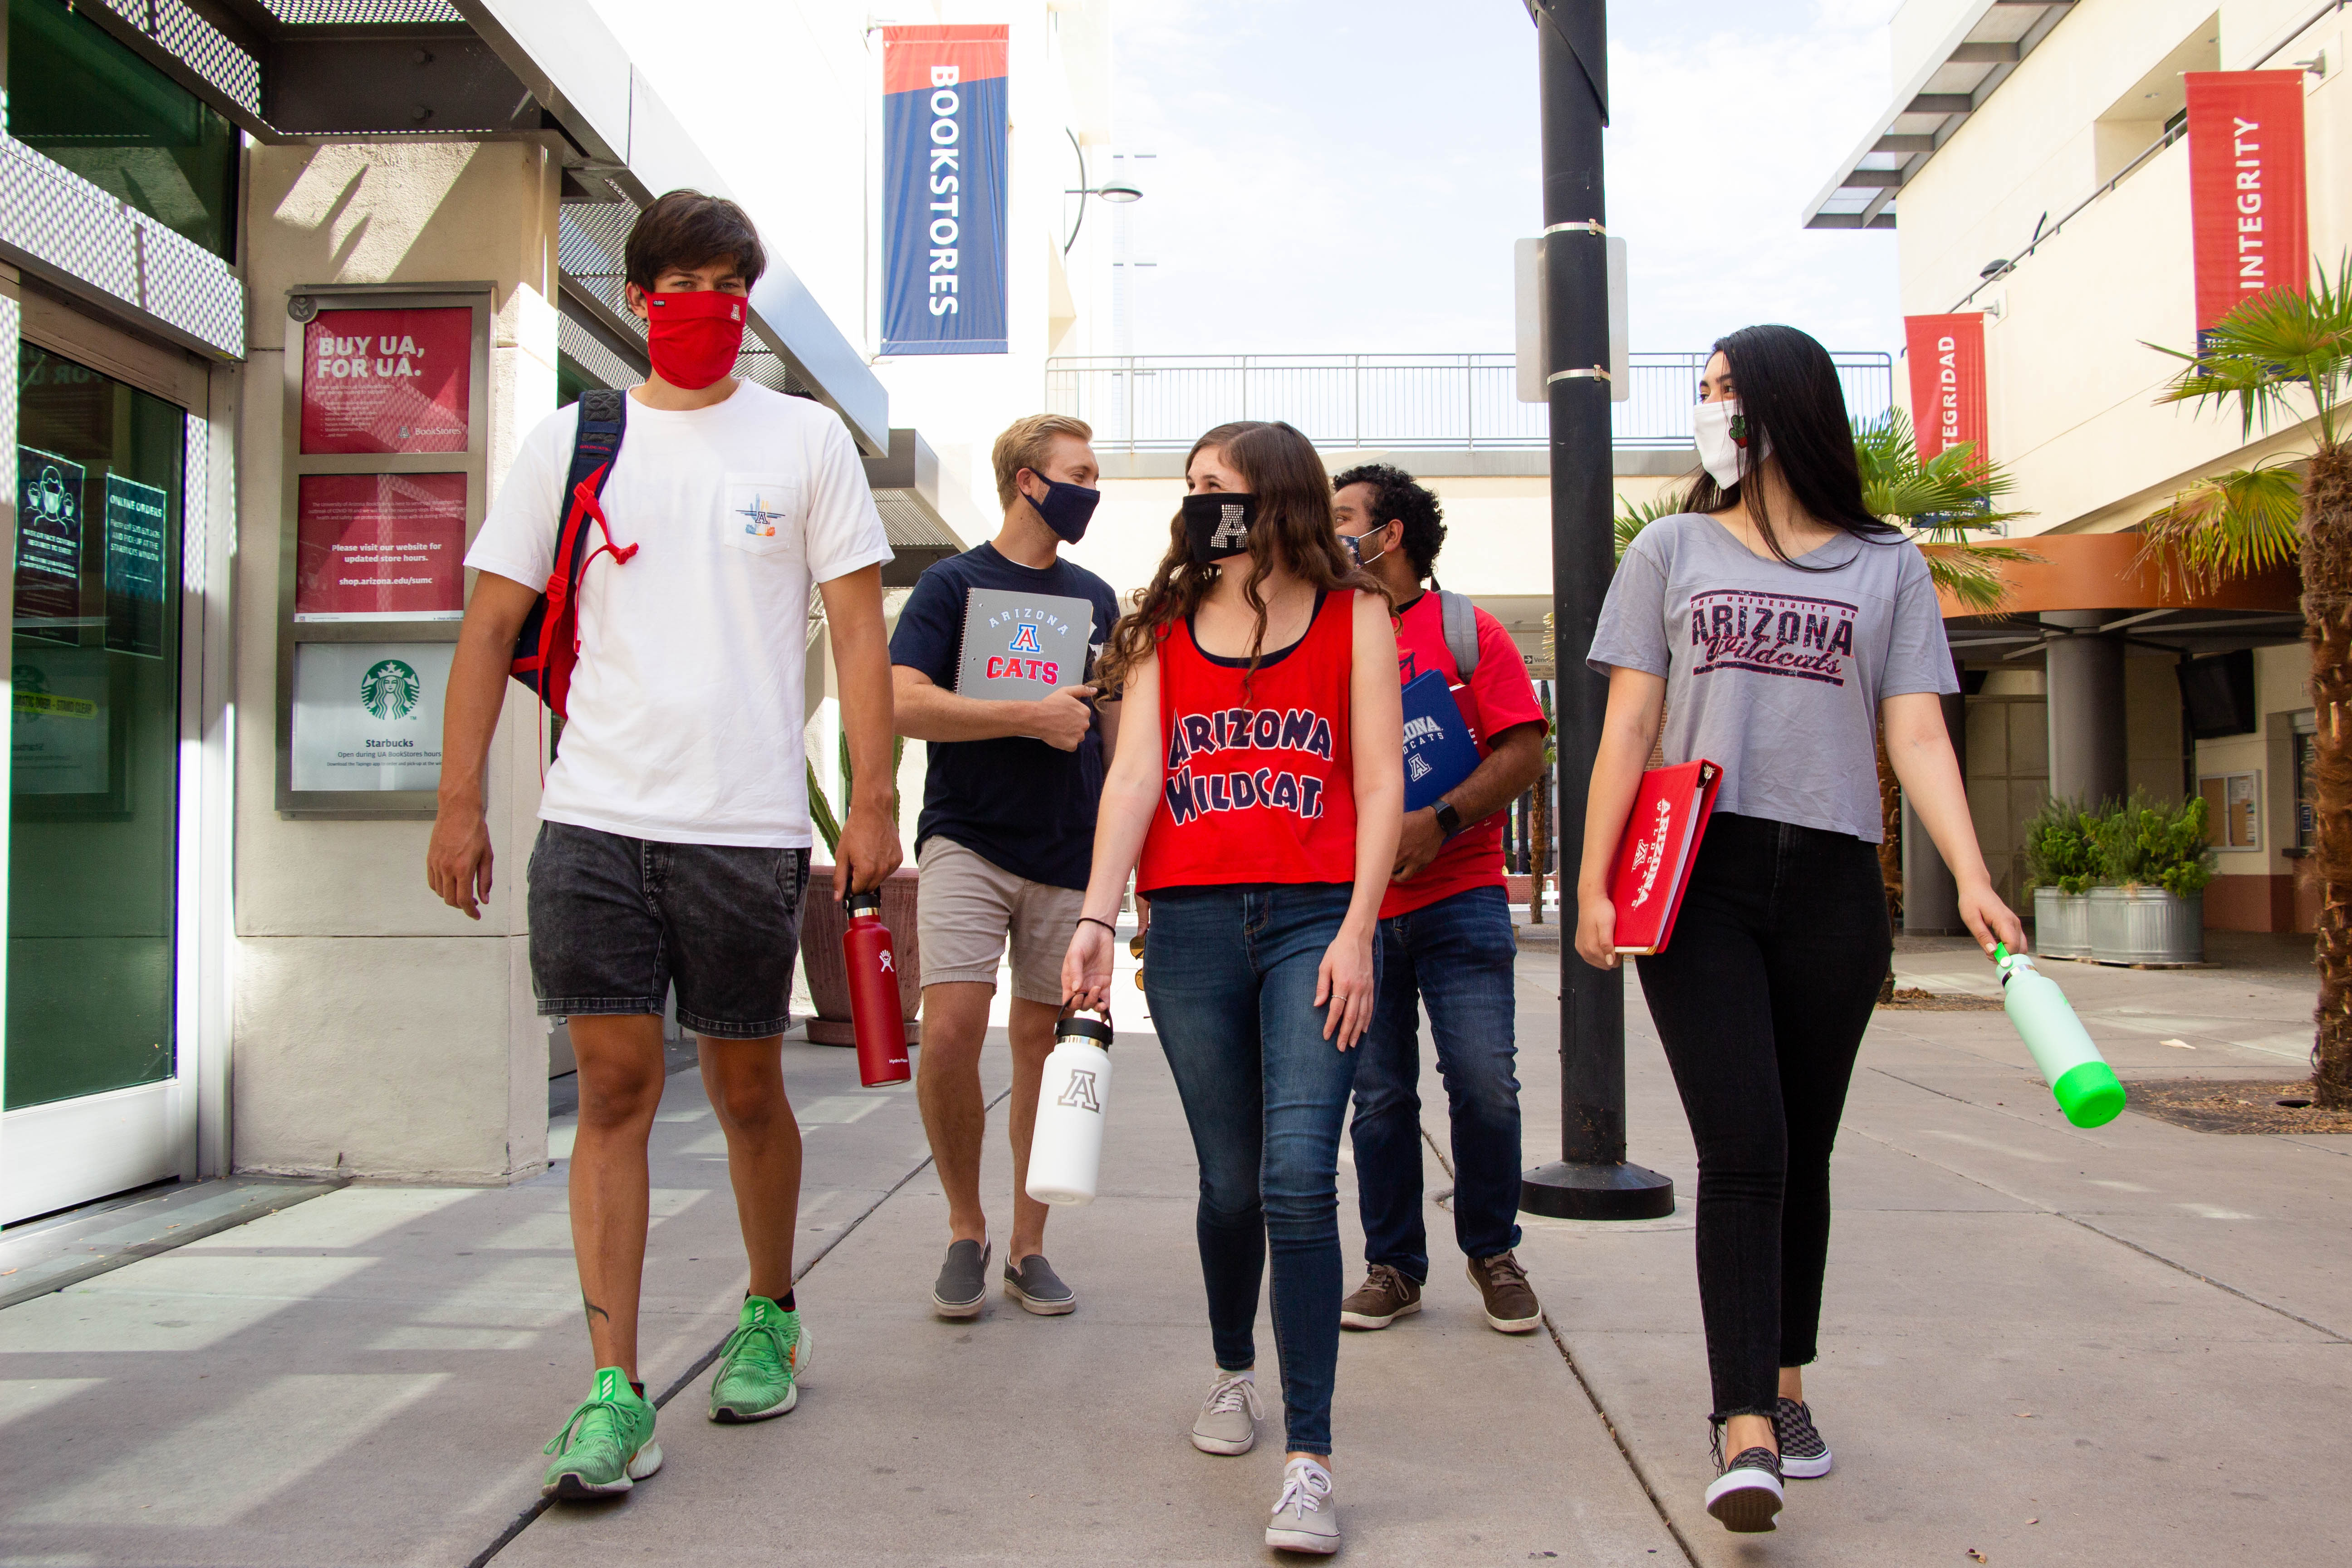
Campus Reentry Plan Overview
How do we return to campus safely?
Prevention Guidelines – physical distance, face coverings (masks), Covid Watch Arizona app, Wildcat Wellcheck
The “Test, Trace, Treat” (3T’s) strategy for Safe Reentry
Everyone Participates: We Keep Each Other Healthy

Slide 4
Four Steps For A Safe Return
Do Your Part – four simple steps for every student to follow when they return to campus this fall.
Get Tested
Mask Up
Download the Covid Watch Arizona app
Join Wildcat WellCheck
Do Your Part webpage:
https://covid19.arizona.edu/

Slide 5
Basic Prevention Guidelines If we don’t follow the guidelines, we risk an outbreak that could shut down the campus. Together, we can stop COVID-19 in our community.
Maintain social distance of 6 feet whenever possible.
Face coverings (masks) are required inside buildings and outside when social distance of 6 feet is not possible.
Stay home if you feel sick or have symptoms
Do Your Part video: https://arizona.wistia.com/medias/vknkojv06d
Classroom Expectations video: https://arizona.wistia.com/medias/0kswgarbmc

Slide 6
Test, Trace, Treat (the 3T’s) The 3T’s strategy is designed to stop COVID-19 from spreading among the University of Arizona community when we return to campus.
Test to identify who is infected – up to 40% of people who have an active infection show no symptoms and can spread the virus!
Isolate and treat people who test positive for COVID-19 so they don’t spread the virus to others.
Alert persons who may have been exposed to the individual who tested positive so they can self-quarantine, get tested, and stop the spread.
3T’s webpage: https://covid19.arizona.edu/test-trace-treat
Test, Trace, Treat
SECTION

Slide 7
1. TEST
Testing identifies those who have an active viral infection, and clears those who don’t have the virus, so that we can all stay safe.
Three types of tests: 1) Antigen test for active virus 2) PCR test for active virus 3) Antibody test for previous exposure to the virus
Testing identifies people who are infected. Up to 40% of people who have active infections don’t feel sick or experience symptoms, but they can still spread the virus and endanger the health of others.
Testing enables isolation and treatment for those who test positive, and it starts the Contact Tracing process to identify others who may have been exposed in order to stop the spread of the virus.
Get Tested: https://covid19.arizona.edu/covid19-testing
TEST
SECTION

Slide 8
1. TEST
What do I do if I test positive?
Isolate so you don’t spread the virus. You’ll receive support during isolation, and you’ll be given treatment if needed. https://housing.arizona.edu/ua-news/covid-19-testing-information-july-23-2020
Self-Report! It is vital that those who test positive self-report to the UArizona Contact Tracing Team. Time makes a big difference when it comes to stopping the spread of COVID-19. There is a simple self-reporting survey you can complete on your phone. https://health.arizona.edu/SAFER
Answer the phone when the UArizona Contact Tracing Team calls. This will help your friends and the whole campus community stay healthy and safe.
TEST
SECTION

Slide 9
2. TRACE
The idea behind the “Trace” component of the 3T’s strategy is to track down (Trace) and alert anyone who might have been exposed (a Contact) to a person who tested positive for the virus. There are three parts to the “Trace” component:
Traditional Contact Tracing: the UArizona Contact Tracing Team: https://covid19.arizona.edu/app-redcap#contact-tracing-team
Covid Watch Arizona “Exposure Notification” app: https://covid19.arizona.edu/covidwatch
Wildcat WellCheck texting-based health reporting system: https://www.wellcheck.arizona.edu/
TRACE
SECTION

Slide 10
2. TRACE
Traditional Contact Tracing
Finding people who may have been exposed, alerting those people, stopping the spread of the virus.
Established and reliable method to stop the spread
UArizona Contact Tracing Team Team at Zuckerman College of Public Health – proven public health Team, powered by student and staff volunteers
VITAL: Relies on self-reporting and cooperation
TRACE
SECTION

Slide 11
2. TRACE
Covid Watch Arizona
Exposure Notification app, uses Bluetooth technology, completely anonymous
Innovative Technology from Apple and Google, users receive an “exposure notification” alert if they have been near a user who tested positive.
Everyone on campus needs to download, #beardownload!
VITAL: Depends on self-reporting and widespread participation
TRACE
SECTION

Slide 12
2. TRACE
Covid Watch Arizona: How to Download
Exposure Notification app, uses Bluetooth technology, completely anonymous
On iPhones, in the App Store, search for ”Covid Watch Arizona” to find the app for free download
On Android phones, in Google Play, search for “CovidWatch” (one word) to find the app for free download
TRACE
SECTION

Slide 13
2. TRACE
Wildcat WellCheck
Texting-based system for self-reporting health status, not an app (no download), delivers custom information from Campus Health.
Information Exchange channel with Campus Health to make sure everyone has the services, support, and answers they need
Everyone needs to join and report daily when they come to campus – required by UArizona
VITAL: Relies on self-reporting and participation
If you were tested off-campus (not by Campus Health) and receive a positive test, report to Campus Health! Call direct: 520-621-9202
TRACE
SECTION

Slide 14
2. TRACE
REVIEW: There are three parts to the “Trace” component:
Traditional Contact Tracing: the UArizona Contact Tracing Team: https://covid19.arizona.edu/app-redcap#contact-tracing-team
Covid Watch Arizona “Exposure Notification” app: https://covid19.arizona.edu/covidwatch
Wildcat WellCheck texting-based health reporting system: https://www.wellcheck.arizona.edu/
TRACE
SECTION

Slide 15
3. TREAT
Campus Health leads the “Treat” component of the 3T’s strategy. Those who test positive for COVID-19 will be treated with wrap-around support, and they should:
Stay home and isolate to stop the spread
Self-report to Campus Health and the UArizona Contact Tracing Team
Campus Health will provide guidance, answers, and healthcare support: https://health.arizona.edu/healthalerts
TREAT
SECTION

Slide 16
Test, Trace, Treat (the 3T’s) REVIEW: The 3T’s strategy is designed to stop COVID-19 from spreading among the University of Arizona community.
Test to identify who is infected – up to 40% of people who have an active infection show no symptoms and can spread the virus!
Isolate and treat people who test positive for COVID-19 so they don’t spread the virus to others.
Alert people who may have been exposed to any individual who tested positive so the potentially exposed person can self-quarantine, get tested, and stop the spread.
3T’s webpage: https://covid19.arizona.edu/test-trace-treat
Test, Trace, Treat
SECTION

Slide 17
Test, Trace, Treat (the 3T’s) Do Your Part to stop the spread. Thanks!
Get Tested. Up to 40% of people who have an active infection show no symptoms and can spread the virus).
Mask up. Simple precautions like physical distance and face coverings are our best way to stay safe.
Download Covid Watch Arizona. The fully anonymous Bluetooth app will alert you if you were exposed. Everyone needs to #beardownload!
Join Wildcat WellCheck. Self-report your health, receive custom guidance from Campus Health, required for everyone to keep us all safe and informed.
REVIEW
SECTION

Slide 18
Thank You for Being an Ambassador!
Be thoughtful
Be compassionate
Support each other

Slide 19
Thank You for Being an Ambassador!
MISSION: We Keep Each Other Healthy
GOAL: Our campus remains open for in-person teaching, learning, and research

Slide 20
Helpful Links for Ambassadors
Be thoughtful, be compassionate, support each other. Together we crush COVID!
Campus Health: https://health.arizona.edu/
UArizona Face Coverings (Mask) Guidelines Page: https://covid19.arizona.edu/face-coverings
UArizona Test, Trace, Treat Page: https://covid19.arizona.edu/test-trace-treat
UArizona COVID-19 Testing Page: https://covid19.arizona.edu/covid19-testing
UArizona Traditional Contact Tracing Page: https://covid19.arizona.edu/app-redcap#contact-tracing-team
Housing and Residence Life: https://housing.arizona.edu/ua-news/final-move-information-ua-housing-august-12-2020
Counseling and Psych Services (CAPS) https://health.arizona.edu/counseling-psych-services

