Slide 1
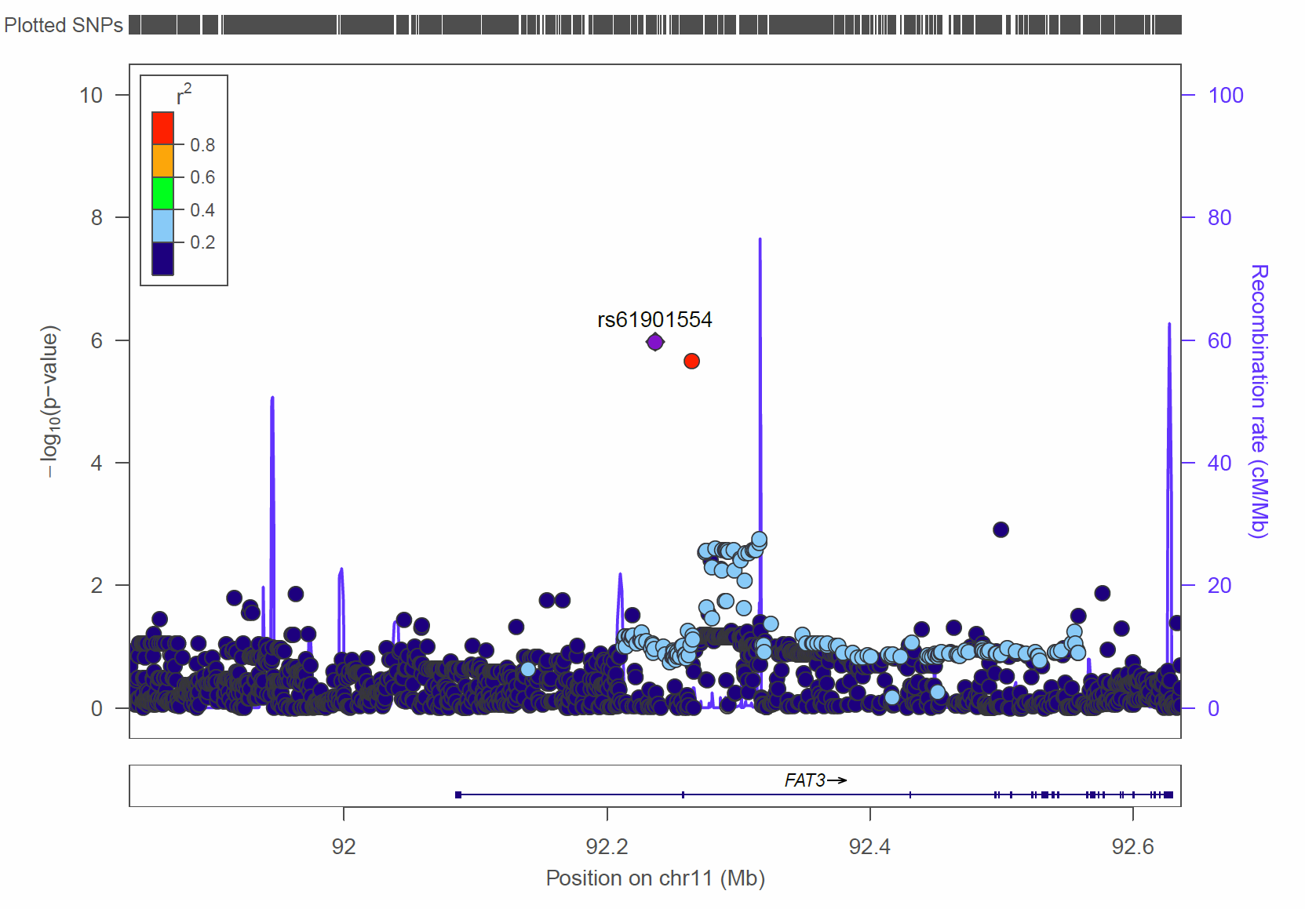
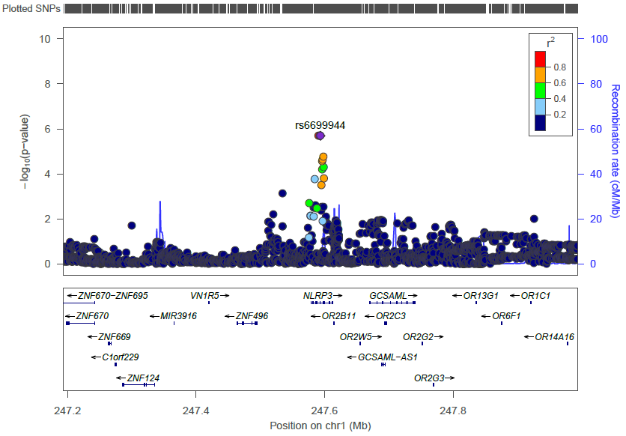
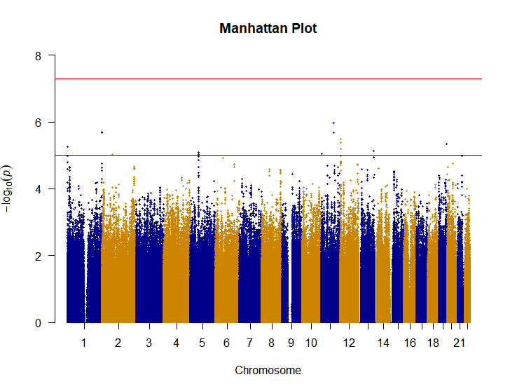
Genome-wide Association Study of Colorectal Adenoma Recurrence in the Selenium Trial
Mario J. Trejo¹, Ken Batai², H.H. Sherry Chow^{3,4}, Nathan Ellis⁵, Peter Lance^{3,4}, Paul Hsu¹, Elizabeth T. Jacobs^{1,3} ¹Department of Epidemiology and Biostatistics, University of Arizona, ²Department of Urology, University of Arizona, ³University of Arizona Cancer Center ⁴Department of Medicine, College of Medicine, University of Arizona, ⁵Department of Cellular and Molecular Medicine, University of Arizona
Background
results
Figure 3: LocusZoom plots for overall adenoma recurrence top SNPs rs61901554 (FAT3) and rs6699944 (NLRP3).
Genetic variation may be related to recurrent colorectal adenomas
There have been no GWAS examining this relationship
The Selenium Trial, a phase III, randomized, double-blind, placebo-controlled trial, examined the effect of selenium supplementation and adenoma recurrence
Genetic variants associated with metachronous adenoma may help identify those at highest risk of adenoma development
Purpose: Identify genetic variants that are associated with the development of metachronous colorectal adenoma
On average, participants were 63 years old and mostly male (Table 1)
Identified variants at two independent loci that are suggestively associated with adenoma recurrence (P<10⁻⁵) [Figure 2 and Figure 3]
rs61901554, an intron variant of FAT atypical cadherin 3 in the FAT3 gene
rs12728998 and rs6699944 (in perfect linkage disequilibrium), in NLRP3, a gene encoding cryopyrin which forms inflammasomes
rs61901554
Table 1: Participant Characteristics
Characteristic | Total N=1215 (100%) | No Recurrent Adenoma N=681 (56%) | Recurrent Adenoma N=534 (44%) | P-Value
Sex N(%) |  |  |  | 0.0002
Female | 433 (35.6) | 274 (40.2) | 159 (29.8)
Male | 782 (64.4) | 407 (59.8) | 375 (70.2)
Age* Mean (SD) | 63.3 (8.8) | 62.4 (9.1) | 64.3 (8.4) | 0.0001
Se
rs6699944
methods
* at Randomization
Figure 2: Manhattan plot showing the association with adenoma recurrence
Selenium Trial Inclusion Criteria:
Ages 40-80 years
Removal of at least one adenoma
No familial polyposis
No hereditary colorectal cancer
There were 1621 participants in the selenium trial of which, 1215 were used for this analysis (Figure 1)
Logistic regression analyses were used to identify genetic variants associated with overall adenoma recurrence, advanced metachronous adenoma and multiple metachronous adenoma
Adjusted for age, sex, randomization group and 3 principal components
rs6699944
rs12729889
rs61901554
discussion
First GWAS examining recurrent adenomas
Provides new insight into genetic basis of the development of metachronous adenoma
FAT3 has been previously found to be associated with advanced adenoma
NLRP3 has been previously found to be associated with poorer survival in colorectal cancer patients
Limitations to our study include a small sample size, and no replication analysis at this point
Variants may help identify those at highest risk of developing metachronous adenoma
1621 participants in the Selenium Trial
624,110 SNPs after QC
5,380,949 SNPs from 1215 participants of European descent available for analysis
Table 2: Overall adenoma recurrence GWAS top SNPs.
SNP ID | CHR:BP | Gene | MA | Overall Adenoma Recurrence OR (95% CI) p-value | Multiple Metachronous Adenoma OR (95% CI) p-value | Advanced Metachronous Adenoma OR (95% CI) p-value
rs61901554 | 11:92236687 | FAT3 | T | 1.67 (1.36, 2.06) 1.1 x 10⁻⁶ | 1.46 (1.05, 2.04) 0.02 | 1.99 (1.42, 2.80) 7.9 x 10⁻⁵
rs6699944 and rs12728998 | 1:247593562 1:247592175 | NLRP3 | A T | 1.68 (1.36, 2.08) 2.0 x 10⁻⁶ | 1.76 (1.27, 2.43) 0.0007 | 1.59 (1.12, 2.28) 0.01
Next steps
Genotyped using Illumina Global Screening
Used 1000 genome project for reported race/ethnicity comparison with genomic ancestry
Identity-by-Descent analysis to identify duplicated samples or related individuals
Imputation using Michigan Imputation Server
Replicate top hits in similar populations
Explore region near FAT3 gene
Figure 1: Genotyping workflow
Sources of support: Financial Support: the National Cancer Institute Cancer Center Support Grant P30 CA023074, NIH/NCI R01CA151708 (ETJ), NIH/NCI P01 CA041108 (PL); and NIH/NCI R01CA151708 (PL).
*CHR = Chromosome, BP = Base Pair, MA = Minor Allele

